Slide 1
DENGUE FEVER:
AN OVERVIEW OF THE BIOLOGY OF DENGUE VIRUS
PRESENTED BY, OKEYO ALLAN

Slide 2
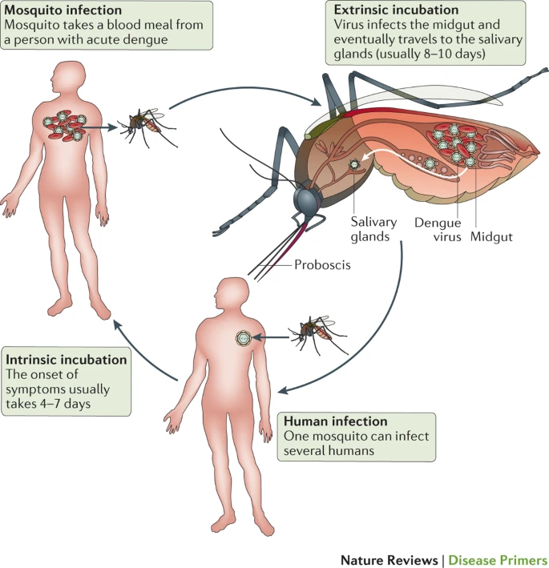
Introduction
Caused by dengue virus
400 million cases annually
Aedes aegypti , Aedes albopticus
Zika, Chikungunya, Yellow fever
Maternal transmission

Slide 3
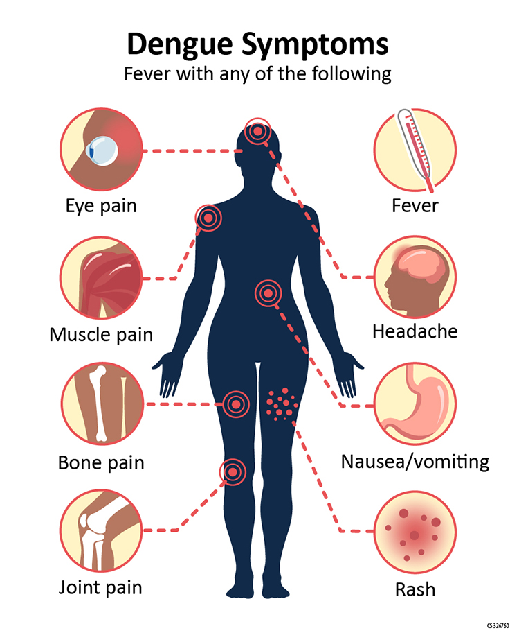
Clinical presentation
Febrile phase
Severe dengue
Severe abdominal pain
Rapid breathing
Blood in vomit
Treatment
Acetaminophen
Avoid NSAIDs
Control
Dengvaxia
Mosquitoes control
Diagnosis
ELISA, RT-PCR
CDC; Dengue fever

Slide 4
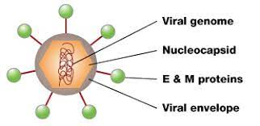
Dengue virus
ssRNA+ virus in the family Flaviviridae
Four serotypes, DENV 1-4
Capsid, envelop and the pre-membrane/membrane
Core; contains the viral genome, C protein
E, protein; roles in attachment, entry, fusion
Nature science;

Slide 5
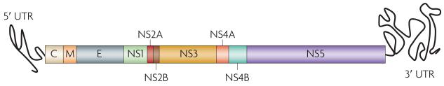
Dengue virus genome
Seven non-structural proteins
E, promotes fusion and attachment.
Three domains, D(I-III)
DIII, host cell receptor binding
180 copes of E proteins
Maria G., 2015

Slide 6
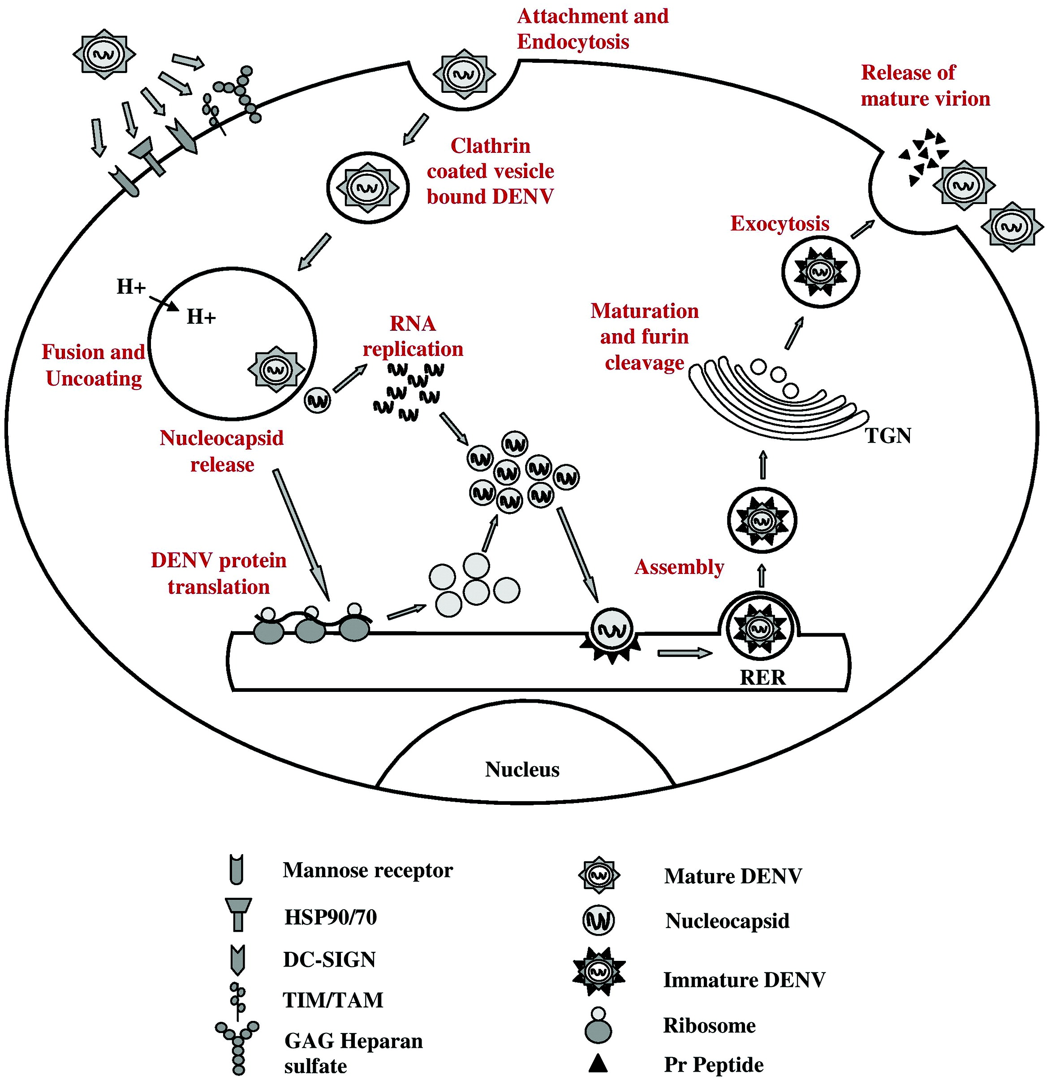
Replication
Attachment factors; glycosaminoglycans , C-type lectins
Singe polypeptide translation
Negative strand formation
Genome packaging
Virion maturation
Sudipta, 2021

Slide 7


